Slide 1
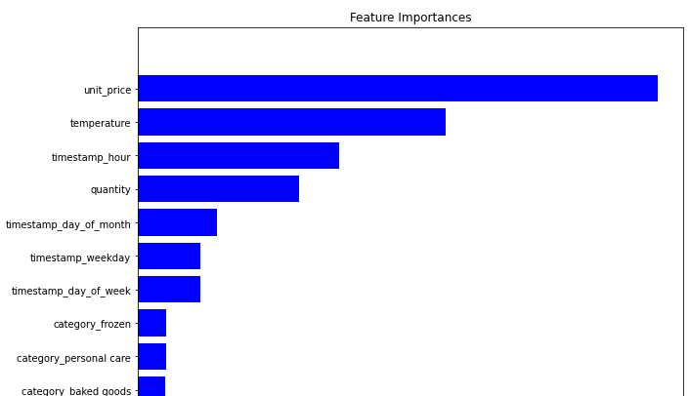
Model Results
This feature importance visualisation tells us:
The product categories were not that important as they have minimal impact
The unit price and temperature were important in predicting stock as they came in highest
The hour of day was also important for predicting stock

